Slide 1
CSCE 1035 Computer Programming I Chapter 6 Functions
University of North Texas

Slide 2

6.1 User-Defined Function Basics

Slide 3

Function Basics
A function is a block of organized, reusable code that is used to perform a single, related action
Functions provide better modularity for applications
We have already seen that Python supports many built-in functions such as print() and input()
But Python also allows you to create your own functions, called user-defined functions
A user-defined function is like a subprogram, a small program inside a program
The basic idea is to write a sequence of statements and then give that sequence a name
We can execute this sequence at any time by referring to the name

Slide 4
Function Definition
The part of the program that creates a function is called the function definition
Function blocks begin with the keyword def followed by the function name and parentheses ()
Any input parameters or arguments should be placed within these parentheses
The code block within every function starts with a colon : and is indented
The statement return [expression] exits a function, optionally passing back an expression to the caller
A return with no arguments is the same as return None
When the function is used in a program, we say the definition is called or invoked

Slide 5
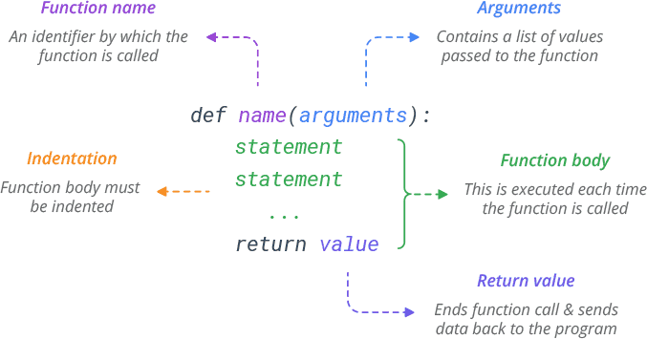
Function Definition

Slide 6
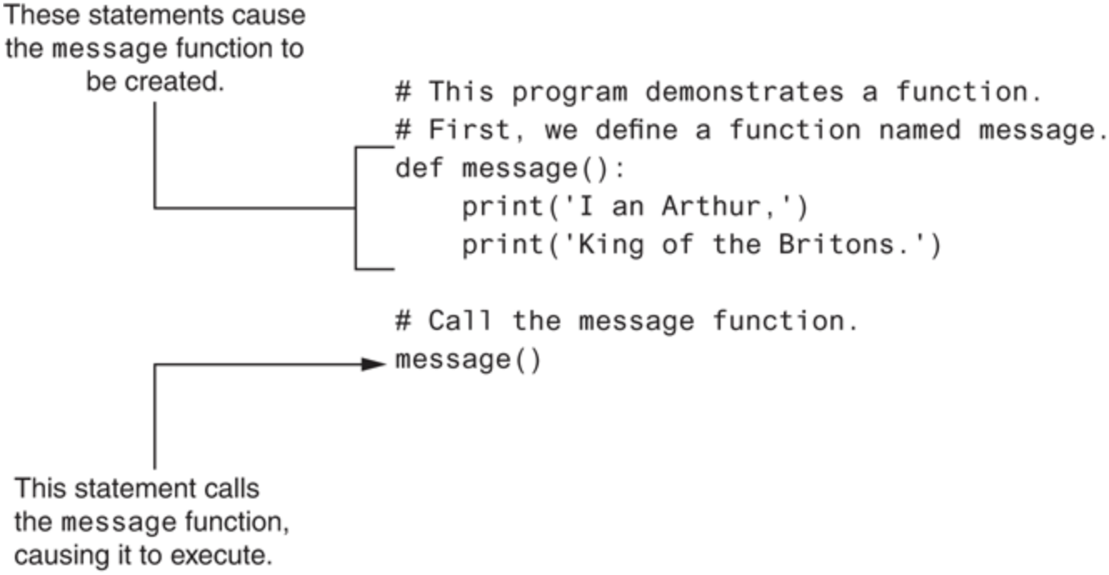
Defining and Calling a Function
The function definition and the function call

Slide 7
6.2 Function Parameters

Slide 8
Function Arguments
Parameters act as input to a function as function variables
Every Python object can be passed as argument to a function
Even a function call be be the argument of a function too
Multiple parameters can be passed to a function
In this case, the order of the arguments in the caller (i.e., the statement that calls the function) must be exactly the same as in the function definition
These are called positional arguments

Slide 9
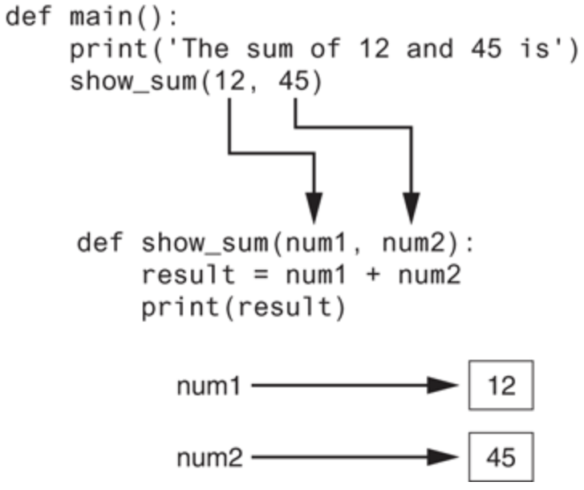
Function Arguments
If we reverse the order in which the arguments are listed in the function call, then 45 would be passed to num1 parameter and 12 would be passed to the num2 parameter
Two arguments passed to two parameters

Slide 10
6.3 Returning Values from Functions

Slide 11
Function Returns
When Python encounters a return statement, it exits the function and returns control to the point where the function was called
The item (as a variable, container, expression, or even a function call) provided in the return statement is sent back to the caller
We can assign the returned item to a variable object or print out the returned result
All functions have a return value, even if no return line
A function may return one item using a return statement
Although a list or tuple with multiple elements can be returned
Functions without a return return the special value None
None is a special constant used like NULL
None is also the logical equivalent to False

Slide 12
6.4 Dynamic Typing

Slide 13
Dynamic Typing and Polymorphism
Python uses dynamic typing to determine the type of objects as a program executes
The type of a variable can change during a program, depending on the value it references
E.g., num = 5, then num = '7'
The interpreter is responsible for checking that all operations are valid as the program executes
Polymorphism means that we can call the same function with parameters, and depending on the parameters, it will yield different results
A function that can operate on different object types is said to be polymorphic

Slide 14
6.5 Reasons for Defining Functions

Slide 15
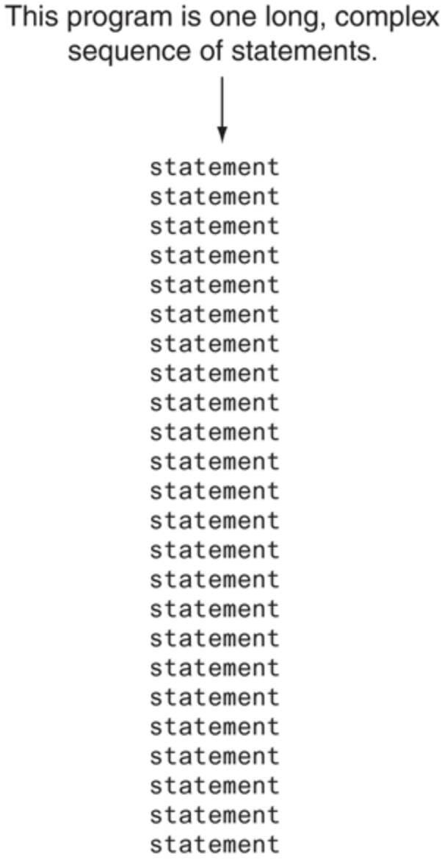
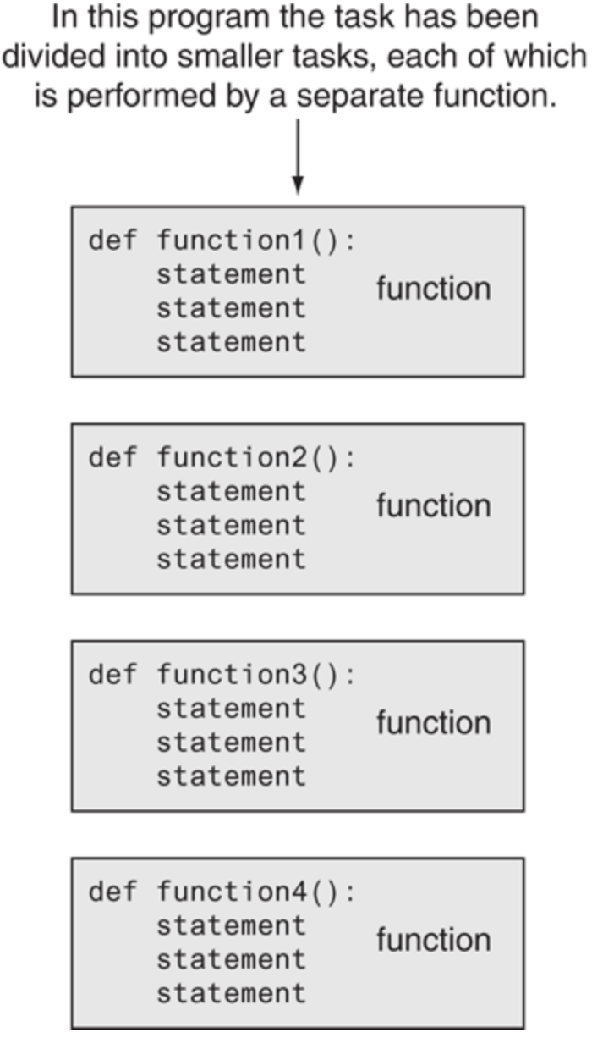

Motivation for Functions

Slide 16
Benefits of Functions
The benefits of using functions include
Simpler code
Code re-use
Write the code once, and call it multiple times
Better testing and debugging
Can test and debug each function individually
Faster development
Easier facilitation of teamwork
Different team members can write different functions

Slide 17
6.6 Function Stubs

Slide 18
Function Stubs
When writing a program with functions, we have a problem
How does incremental development fit in?
If our program calls a function, then we need a definition for it
If there are many functions, this means that a large amount of code needs writing before we can test
The solution is to create function stubs
A stub is a skeleton function that acts as a placeholder until a final version is completed
Another alternative is to test out a function before actually adding it to a program
Write a small program that supplies the function with the necessary information to work
These are called driver programs

Slide 19
6.9 Functions: Common Errors

Slide 20
Common Problems with Functions
Copy-and-paste errors
Copy-and-paste code among functions, but forgetting to complete all necessary modifications to the pasted code
Return errors
Every function returns something
Functions without an explicit return pass back a special object called None
None is the absence of a value
Writing a function that returns a value, but forgetting to…
include the return statement
assign that value to anything

Slide 21
6.10 Scope of Variables and Functions

Slide 22
Local and Global Scope
All variables in a program may not be accessible to all locations in that program
This depends on where the variable is declared
The scope of a variable determines the portion of the program where you can access a particular identifier
Variables defined inside a function body have a local scope, while those defined outside have a global scope
This means that local variables can be accessed only inside the function in which they are declared whereas global variables can be accessed throughout the program body by all functions
When you call a function, the variables declared inside it are brought into scope

Slide 23
Local and Global Scope
def a():
b = 10
print(b)
a()
print(b)
How can we fix this?
We can define the variable b outside of the function, which will make it a global variable
b = 10
def a():
print(b)
a()
print(b)
b is local and only known inside function a()
will generate an error since b is not defined here
What about this?
b = 10
def a():
print(b)
b = 20
print(b)
a()
print(b)
Now b is known globally and will print in both locations

Slide 24
Forcing Local Assignment to Global
We can force a local assignment to a global variable using the global keyword
b = 10
def a():
global b
b = 20
print(b)
print(b)
a()
print(b)
But be careful about using global variables in functions as they can be confusing or have side effects that make it hard for a programmer to recognize
Good practice is to limit the use of global variables to defining constants that are independent of any function

Slide 25
6.11 Namespaces and Scope Resolution

Slide 26
Namespaces
A namespace is a mapping from names to objects
More precisely, a namespace is a dictionary of variable names (keys) with their corresponding objects (values)
A Python statement can access variables in a local namespace and in the global namespace
If a local and a global variable have the same name, the local variable shadows the global variable so that the global name is not accessible
Each function has its own local namespace
Class methods (i.e., member functions) follow the same scoping rule as ordinary functions

Slide 27
The dir() Function
The dir() built-in function returns a sorted list of strings containing the names defined by a module
The list contains the names of all the modules, variables, and functions that are defined in a module
Example
>>> import math
>>> content = dir(math)
>>> print(content)
['__doc__', '__loader__', '__name__', '__package__', '__spec__', 'acos', 'acosh', 'asin', 'asinh', 'atan', 'atan2', 'atanh', 'ceil', 'copysign', 'cos', 'cosh', 'degrees', 'e', 'erf', 'erfc', 'exp', 'expm1', 'fabs', 'factorial', 'floor', 'fmod', 'frexp', 'fsum', 'gamma', 'gcd', 'hypot', 'inf', 'isclose', 'isfinite', 'isinf', 'isnan', 'ldexp', 'lgamma', 'log', 'log10', 'log1p', 'log2', 'modf', 'nan', 'pi', 'pow', 'radians', 'sin', 'sinh', 'sqrt', 'tan', 'tanh', 'tau', 'trunc']

Slide 28
The globals() and locals() Functions
The globals() and locals() functions can be used to return the names in the global and local namespaces, respectively, depending on the location from where they are called
If locals() is called from within a function, it will return all the names that can be accessed locally from that function
If globals() is called from within a function, it will return all the names that can be accessed globally from that function
The return type of both these functions is a dictionary
Therefore, names can be extracted using the keys() function

Slide 29
Scope Resolution
Python supports the following namespaces in the following order of lookup
Local namespace
Specific to the current function or class method
Same as global scope if no function is executing
Global namespace
Specific to the current module
Contains all globally defined names outside of any functions
Built-in namespace
Global to all modules
Contains all built-in names such as int(), str(), list(), etc.

Slide 30
6.12 Function Arguments

Slide 31
Passing Arguments to Functions
Two ways in which arguments can be passed to functions
Pass by value
Function creates a copy of the object passed to it as an argument
The actual object is not affected
The object is an immutable type (cannot be modified)
Pass by reference
The actual object is passed to the called function
All changes made to object inside function affect its original value
The object is a mutable type
Since mutable objects can be changed, the passed objects are updated
Can make a mutable object immutable by passing a copy of it instead (e.g., passing my_list[:] instead of my_list)

Slide 32
6.13 Keyword Arguments and Default Parameter Values

Slide 33
Keyword and Default Arguments
It is possible to assign a name to the arguments of a function
Keyword arguments identify arguments by parameter name
In this case, the order is not important if all arguments have keywords
Keyword arguments can be mixed with positional arguments, but only if the keyword arguments come last
It is also possible to use default arguments
A parameter’s default value is used in the absence of an argument in the function call
These optional arguments must be placed in the last position(s) of the function definition
Be careful about working with mutable objects (e.g., a list) using a default parameter
Default arguments are created only once, so a default empty list with multiple calls may not be empty after first function call

Slide 34
6.14 Arbitrary Argument Lists

Slide 35
Non-Keyword Arguments
The special syntax *args in function definitions is used to pass a variable number of arguments to a function
It is used to pass a non-key worded, variable-length argument list
The syntax is to use the symbol * to take in a variable number of arguments
By convention, it is often used with the word args
The *args allows more arguments than the number of formal arguments defined by the function
With *args, any number of extra arguments can be tacked on to your current formal parameters (including zero extra arguments)
Using the *, the variable that we associate with the * becomes an iterable, meaning that you can do things like iterate over it

Slide 36
Keyword Arguments
The special syntax **kwargs in function definitions is used to pass a key-worded, variable-length argument list
The name kwargs is used with the double star because it allows us to pass through keyword arguments (and any number of them)
A keyword argument is where you provide a name to the variable as you pass it into the function
You can think of kwargs as being a dictionary that maps each keyword to the value that we pass alongside it
That is why when we iterate over the kwargs, there does not seem to be any order in which they were printed out

Slide 37
6.15 Multiple Function Outputs

Slide 38
Returning Multiple Values
In Python, a function can return multiple values
Specified in the return statement separated by commas
return expression1, expression2, etc.
When you call a function with multiple return values in an assignment statement, you need to separate the variables on the left side of the assignment operator = with commas to receive each returned value
>>> def multiple():
... return 'abc', 123, [4, 'd']
...
>>> print(multiple())
('abc', 123, [4, 'd'])
>>> print(type(multiple()))
<class 'tuple'>
>>> x, y, z = multiple()
>>> print(x, y, z)
abc 123 [4, 'd']
Assigning multiple return values to different variables is known as unpacking

Slide 39
6.16 Help! Using docstrings to Document Functions

Slide 40
Docstrings
Python has a feature called documentation strings, usually referred to as docstrings
Docstrings provide a convenient way of associating documentation with Python modules, functions, classes, and methods
They are specified in source code that is used, similar to a comment, to document a specific segment of code
This allows the program to inspect these comments at run time, for instance, as an interactive help system, or as metadata
The docstring should begin with a capital letter and end with a period
The docstring is printed out when you call help() on the function

